Slide 1
Bear Attack in North America : A Comprehensive Analysis
HANEESHA THASNI N

Slide 2
Introduction
It shows every recorded killing by a black, brown, or polar bear from 1900-2018 in North America.
Analyzing bear attacks in North America
Identifying trends, common factors, and geographic distribution
Offering preventive measures and safety guidelines

Slide 3
Dataset Overview
Total Records : 166 rows x 16 columns
Columns :
Name
Age
Gender
Date
Month
Year
Type
Location
Description
Type of bear
Hunter
Hikers
Grizzly
Only one killed
Latitude
Longitude
Time Range : 1901 – 2018
Missing values are filled and dropped.
Data Source : Kaggle

Slide 4
Analysis Objectives
Analyze Gender and Age Distribution of Bear Attack Victims
Compare Bear Attack Incidents: Wild vs. Captive Settings
Examine Incident Trends Over Time (Years/Months)
Investigate Bear Attacks on Hikers and Hunters by Month
Visualize Bear Attack Intensity by Location

Slide 5
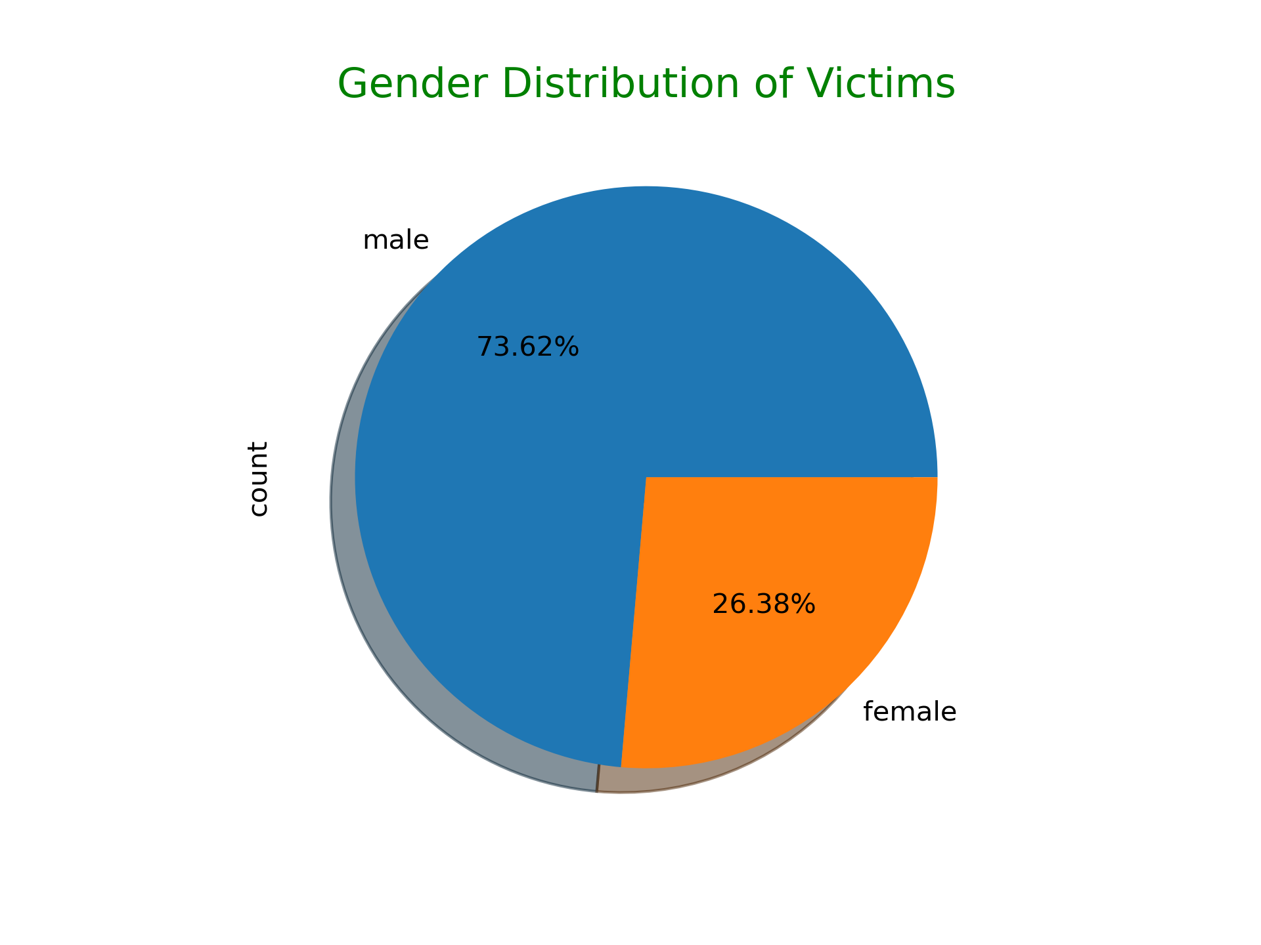
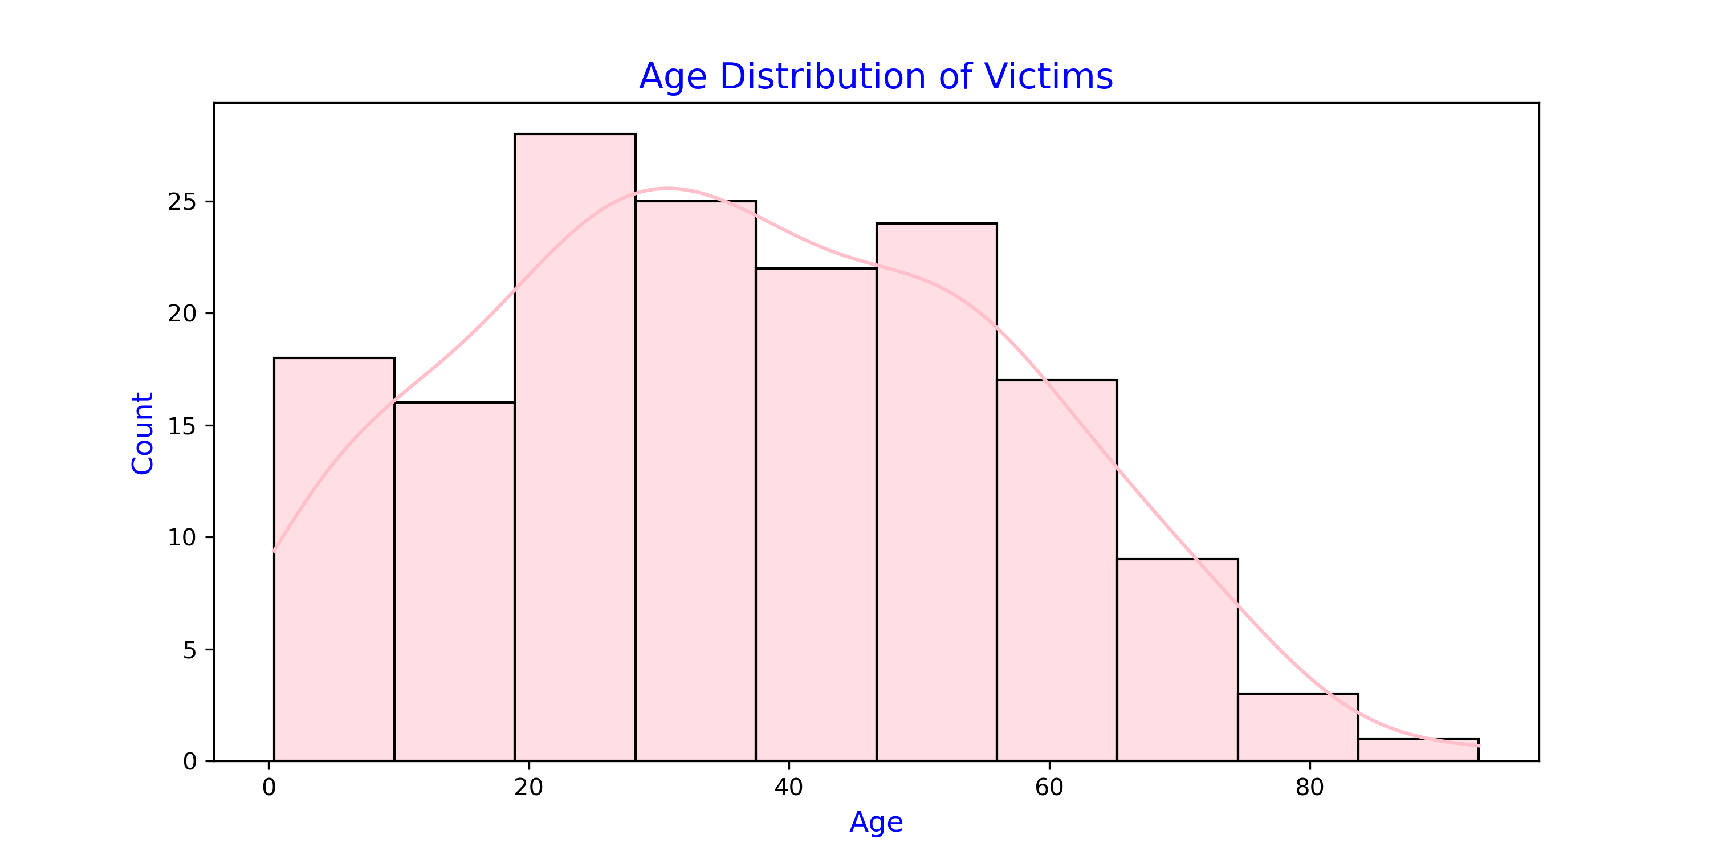
Gender and Age Distribution of Bear Attack Victims
Highest number of victims are fall in middle aged ranges, particularly between 20 and 50.
The majority of bear attack victims are male.

Slide 6
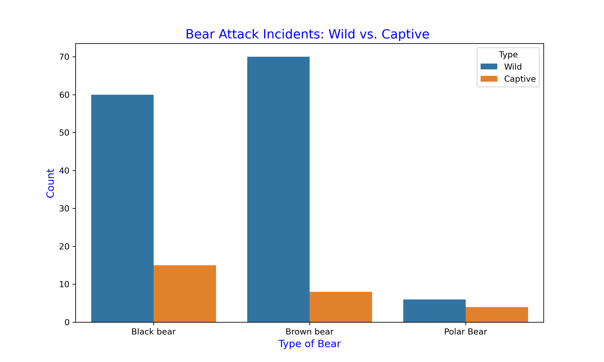
Bear Attack Incidents: Wild vs. Captive
Wild animals are mostly attacked, with Brown bears being the most aggressive compared to Black bears, while Polar bears have the fewest attacks.

Slide 7
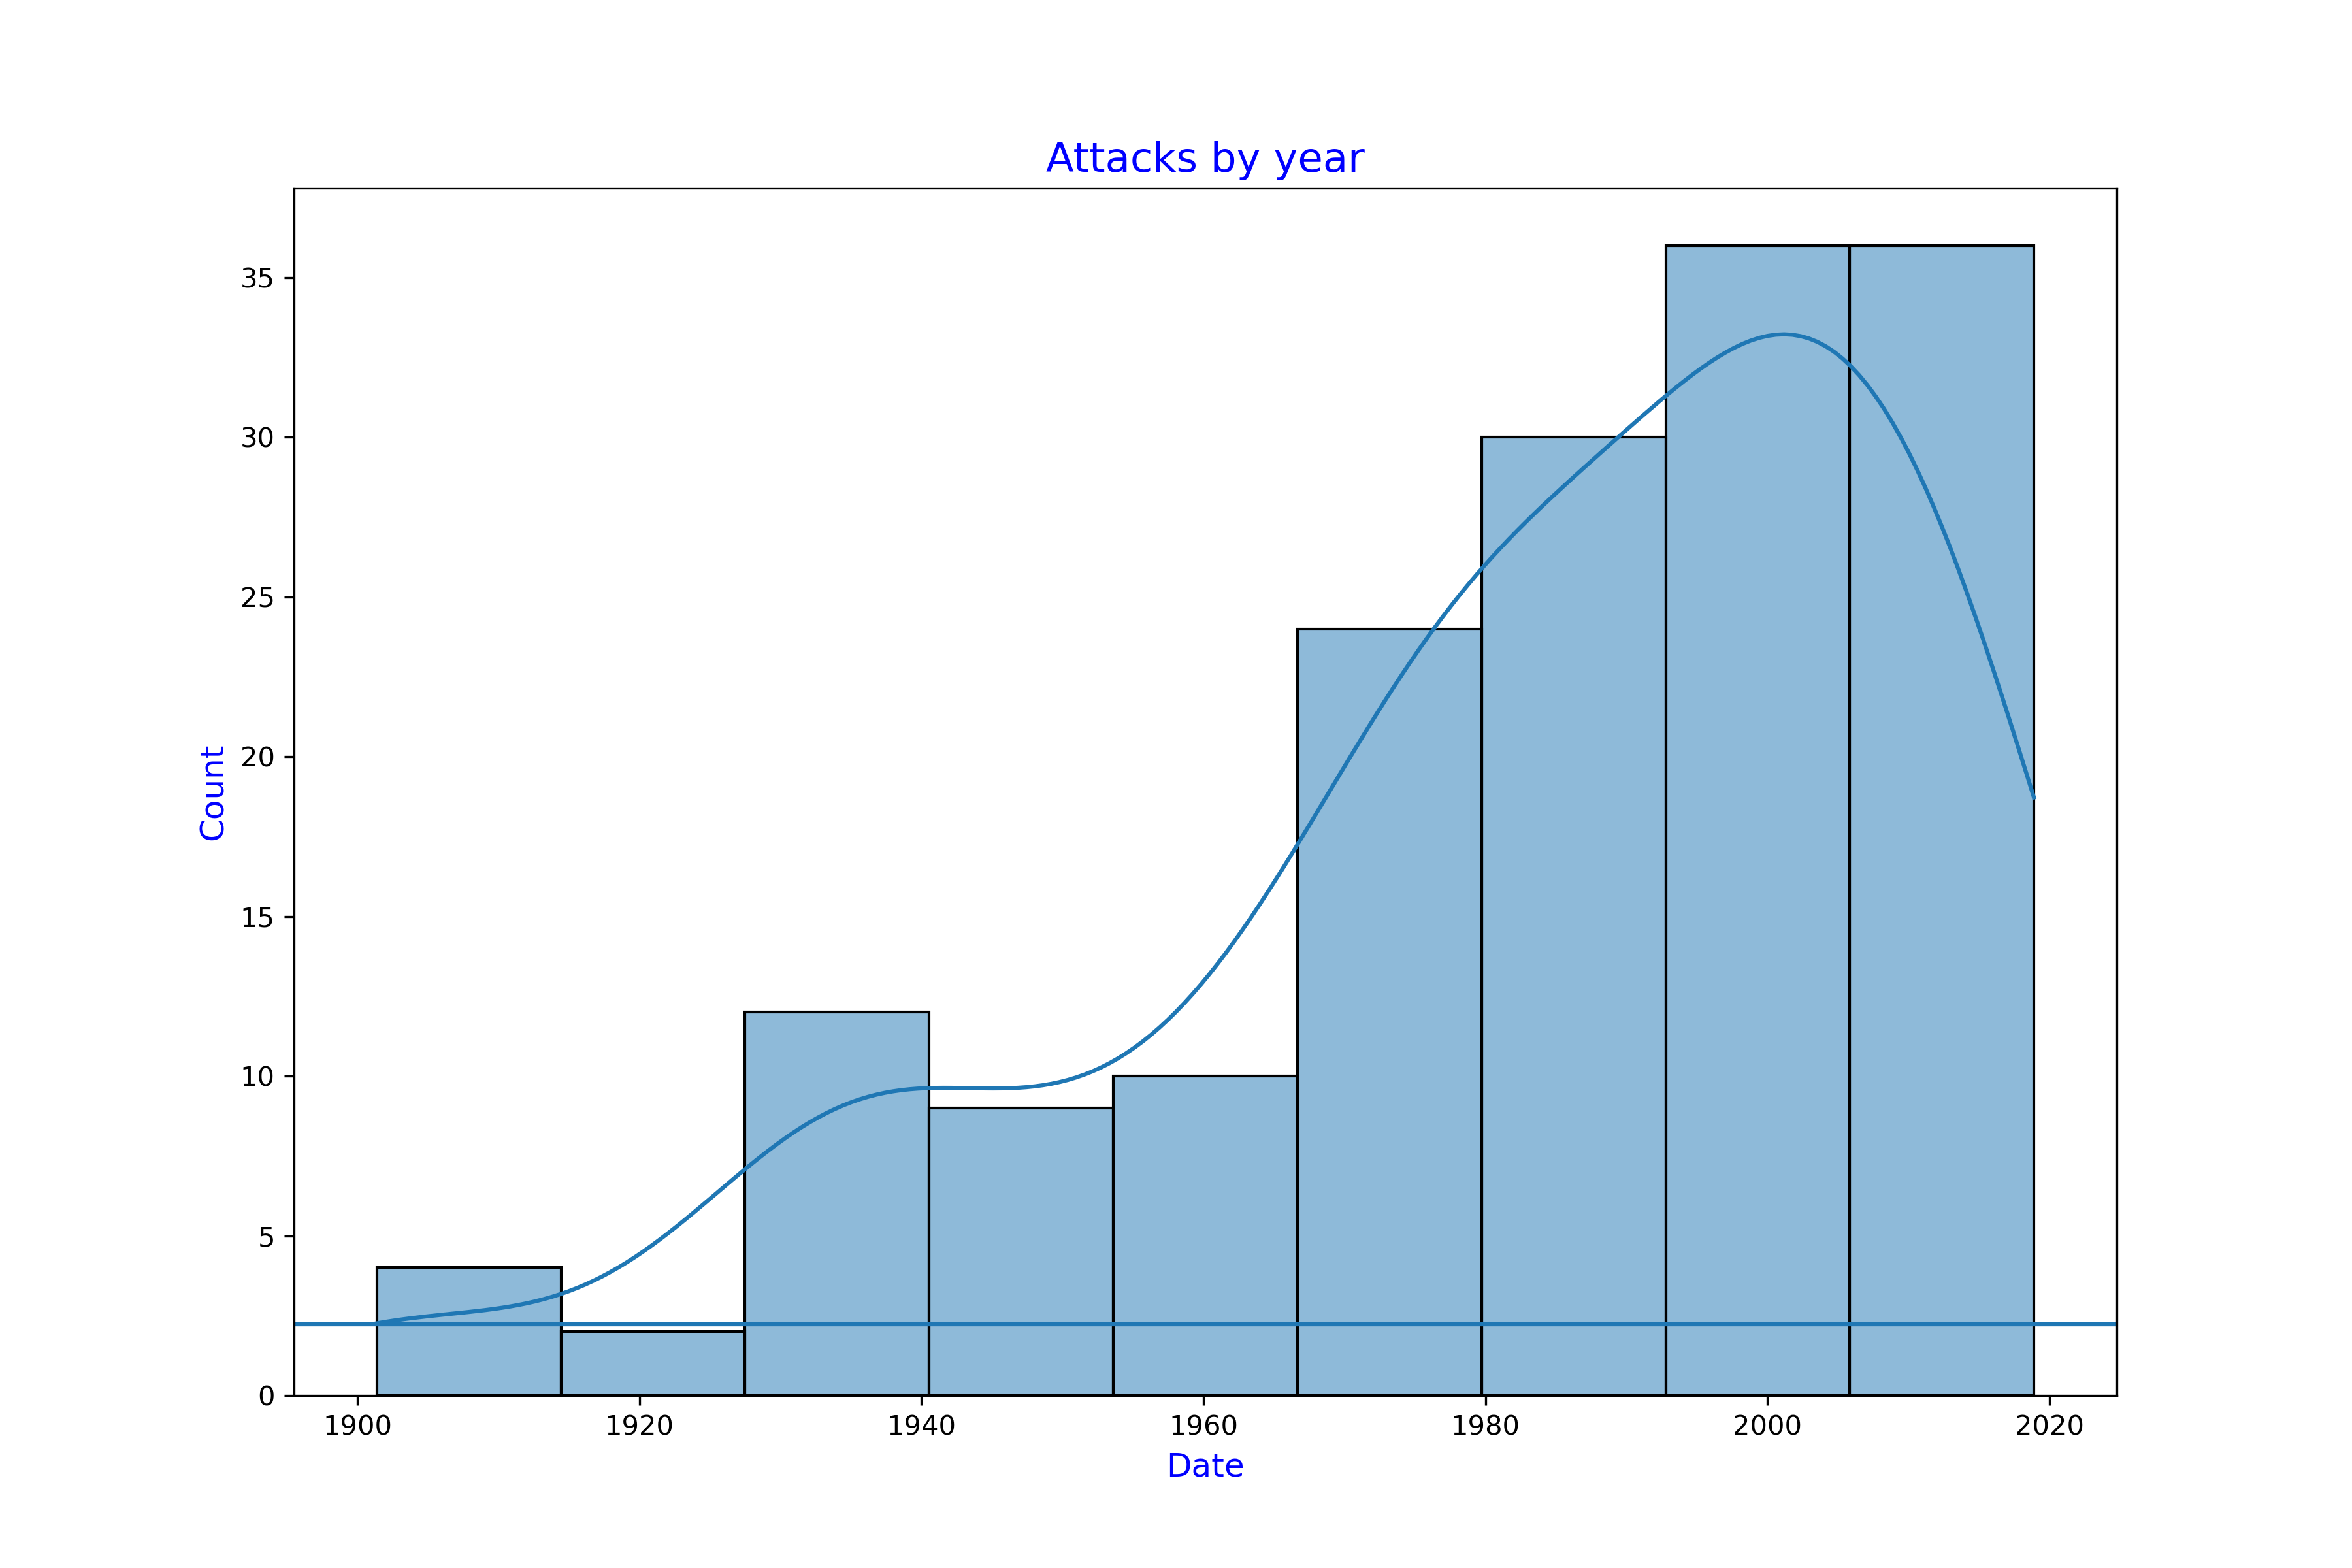
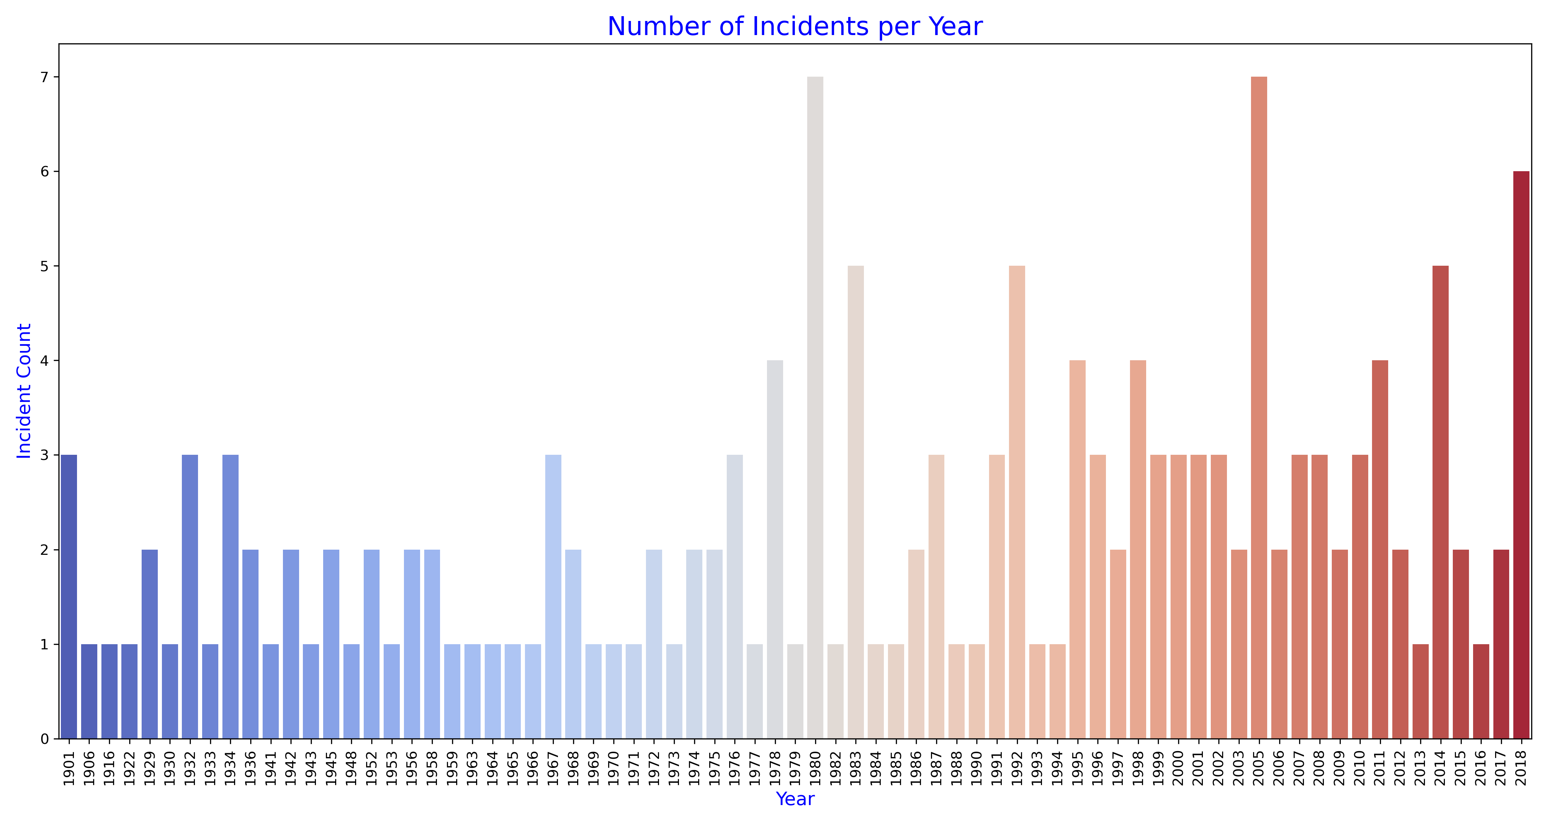
Incident Trend over Time ( Years )
Sharp increase from 1970
1980,2005 and 2018 are the years with higher number of incidents.
1983,1992 and 2014 are also higher compared to other year.

Slide 8
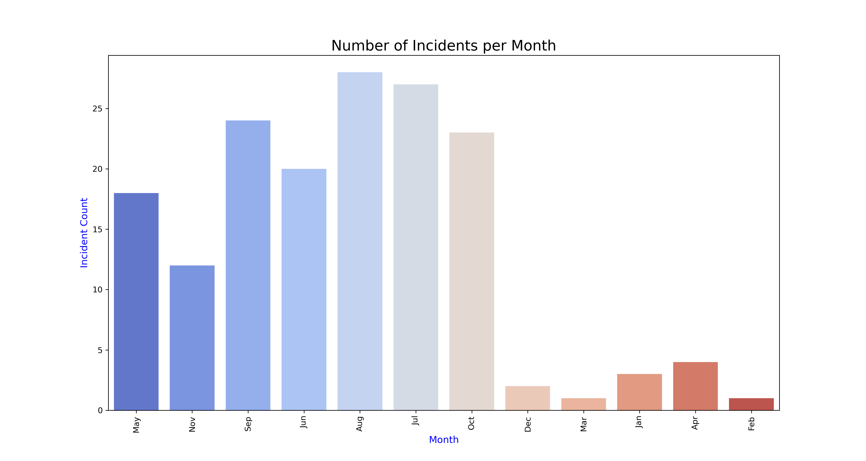
Incident Trend over Time ( Months)
Highest Incidents in August and July:
This could be attributed to increased human activity in bear habitats during summer months, when outdoor activities such as hiking, camping, and hunting are more common.
Significant Incidents in September and October:
The months of September and October also exhibit a higher frequency of bear attacks, likely due to the increased movement of bears during the fall season as they prepare for hibernation.
Lower Incidents in Winter and Early Spring:
December, January, February, and March show notably fewer incidents, which aligns with the bears' hibernation period, where bear activity is significantly reduced.
April also shows fewer incidents, as it marks the transition out of winter and the early stages of bear activity resuming.

Slide 9
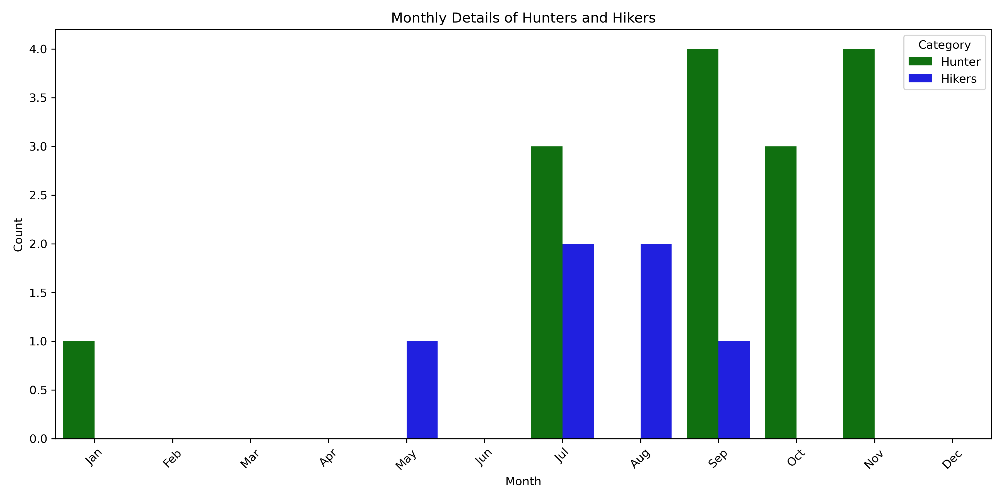
Bear Attacks on Hikers and Hunters by Month

Slide 10
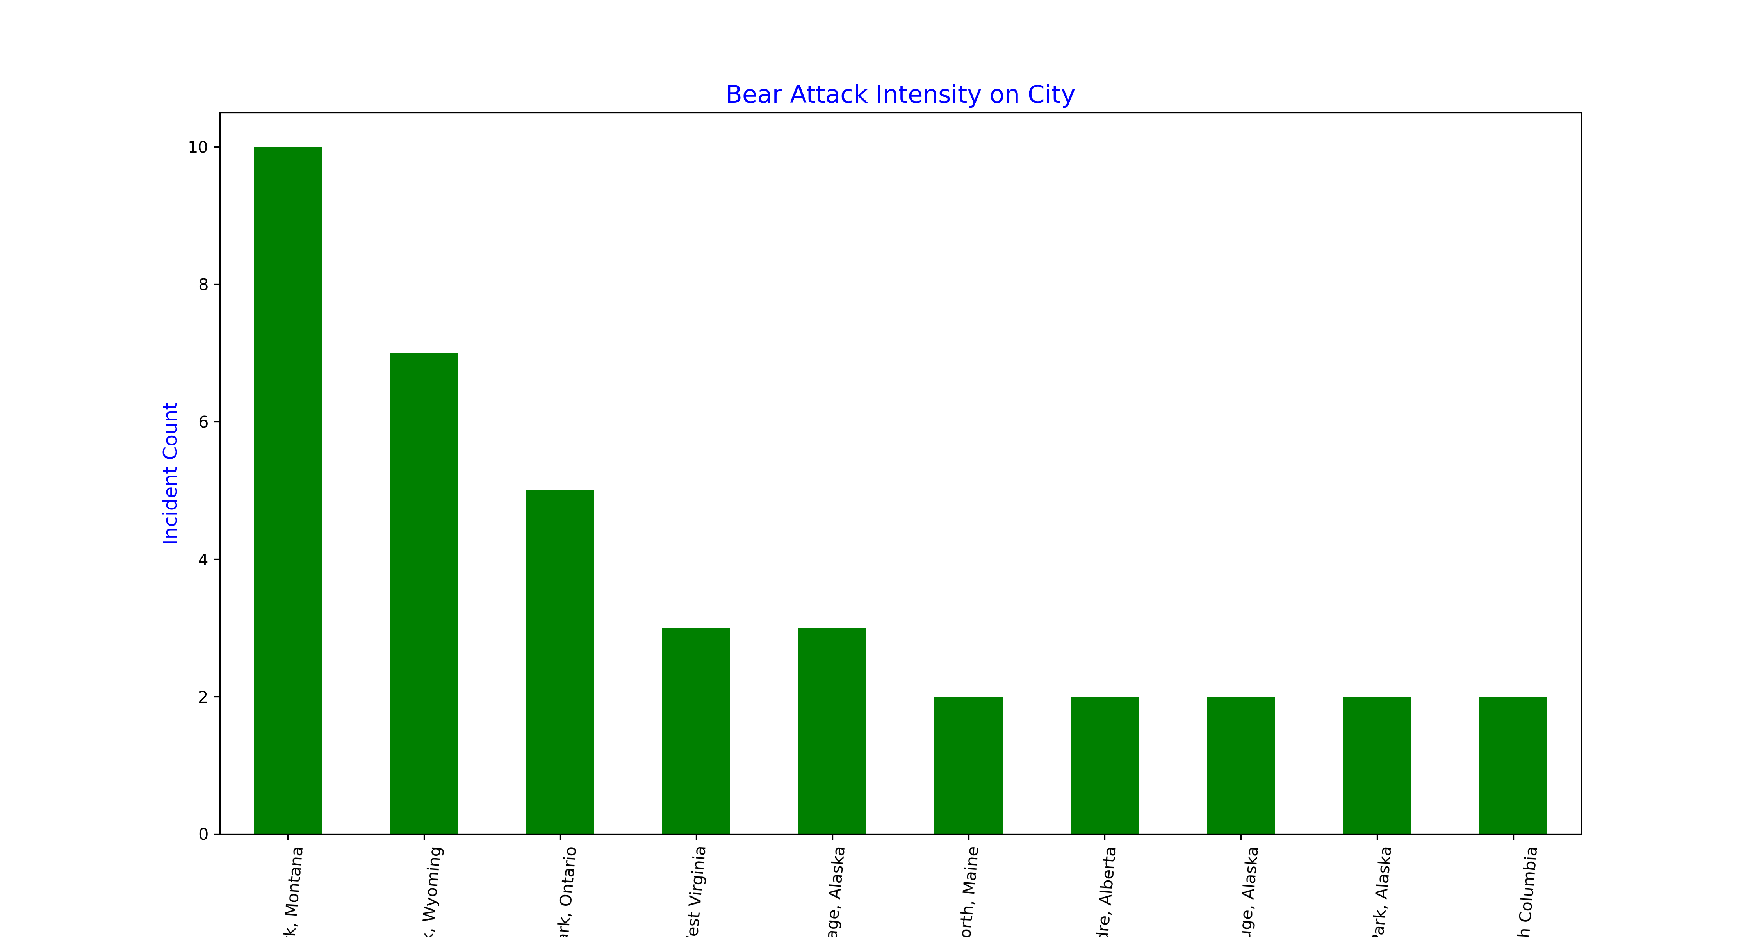
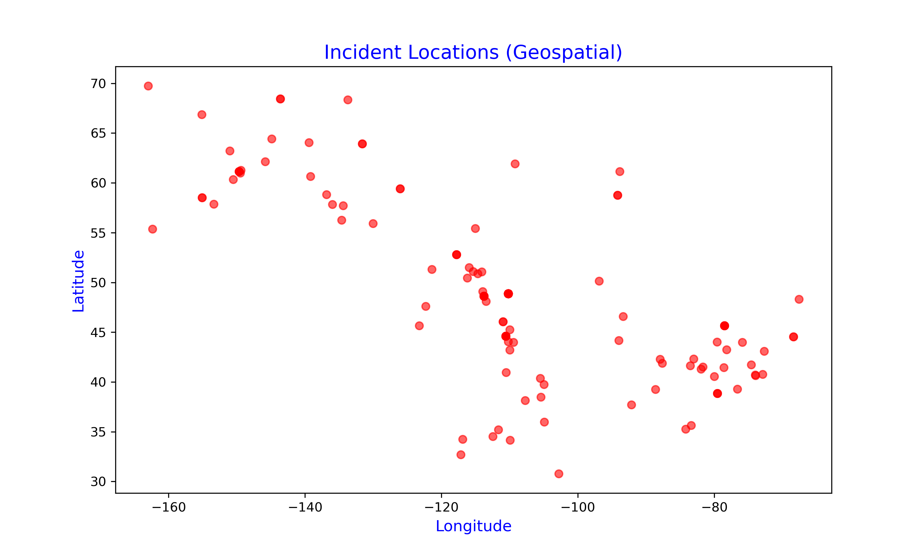
Visualizing Bear Attack Intensity on Location
Glacier National Park, Montana:
Highest intensity with 10 incidents per month, indicating a significant concern for visitor safety and wildlife management.
Yellowstone National Park, Wyoming:
Moderate intensity with 7 incidents per month, suggesting a need for continued monitoring and safety measures.
Algonquin Provincial Park, Ontario:
Lower intensity with 5 incidents per month, yet still noteworthy for park authorities and visitors.

Slide 11
Recommendations
Enhance safety practices and launch awareness campaigns, especially during the high-risk months of July through October.
Boost awareness initiatives and educational programs in regions with higher bear attack rates.
Introduce preventive safety measures during periods of increased bear activity.
Investigate the causes behind the higher occurrence of incidents in specific areas.
Create species-specific educational materials for park visitors and staff to raise safety awareness.
Strengthen management protocols for captive bears to minimize the risk of attacks.
Conduct more research into factors contributing to bear aggression and the frequency of human-bear encounters, both in the wild and in captivity.
Improve Incident Reporting: Complete geolocation data (latitude and longitude) for bear attacks to track high-risk areas and improve monitoring.
Real-Time Alerts: Set up alert systems in high-risk areas to warn about bear sightings and prevent encounters.
Monitor Long-Term Trends: There’s been a rise in bear attacks since the 1970s. Investigating reasons like habitat loss and climate change could help develop preventive measures.
Encourage the use of bear deterrents (bear spray, noise devices)

Slide 12
In summary, recognizing high-risk times and areas for bear encounters is essential for improving public safety and minimizing conflicts between humans and bears. The months of May, July, August, September, and October are particularly dangerous, with Glacier National Park and Yellowstone National Park identified as key hotspots. This analysis highlights the need for targeted safety campaigns to educate the public on bear awareness and prevention, alongside further research into bear behavior and human interactions to enhance these safety measures and promote coexistence.

Slide 13
Thank You

